Slide 1
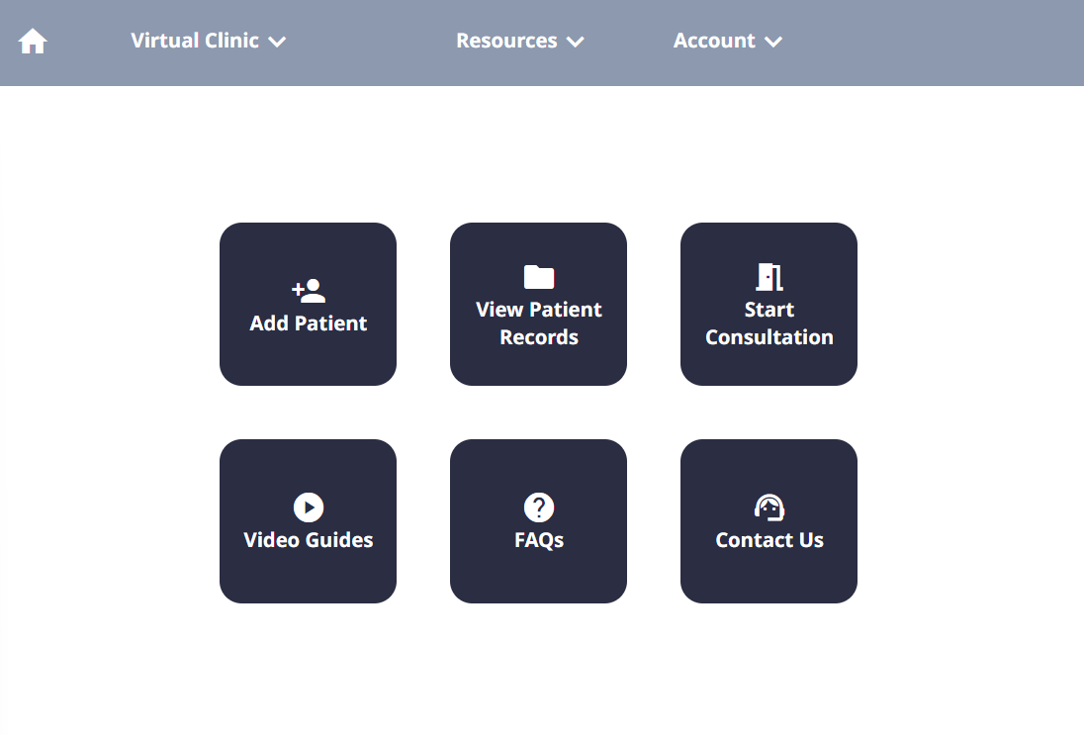
Welcome to your first tutorial. Here, you will learn the basics of how to conduct a consultation with the virtual clinic system.
Click to continue →

Slide 2
To get started, you will need to start a new consultation for your patient, James Jones. Navigate to the patient list by clicking the ‘View Patient Records’ button.

Slide 3
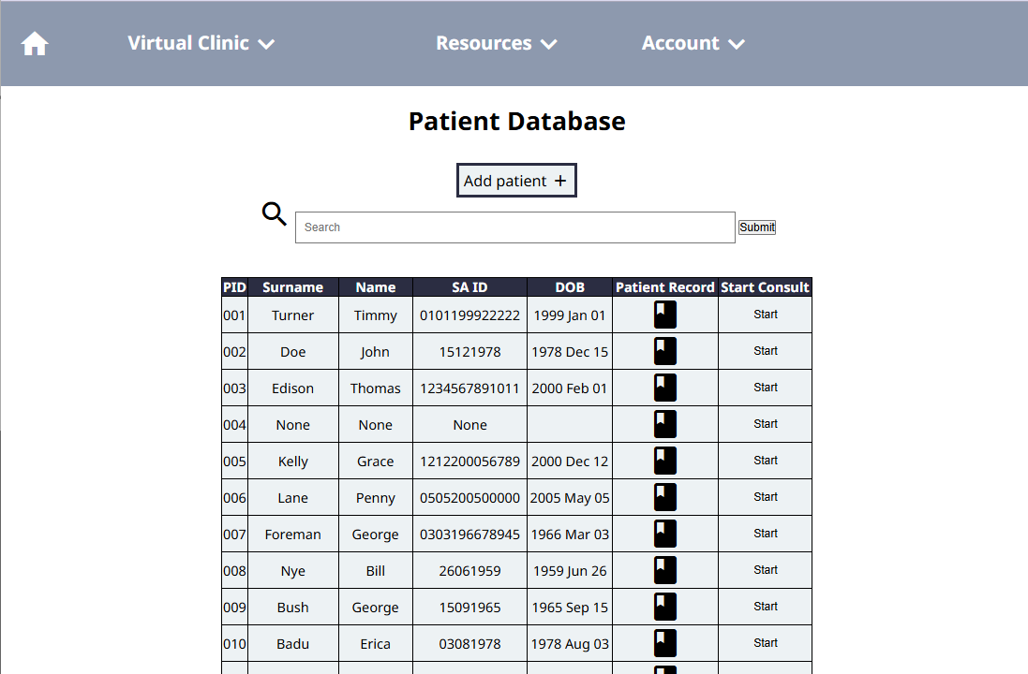
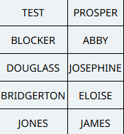
Great. Now, let’s view the patient’s record before we start the consultation. Click the patient record icon for James Jones.

Slide 4
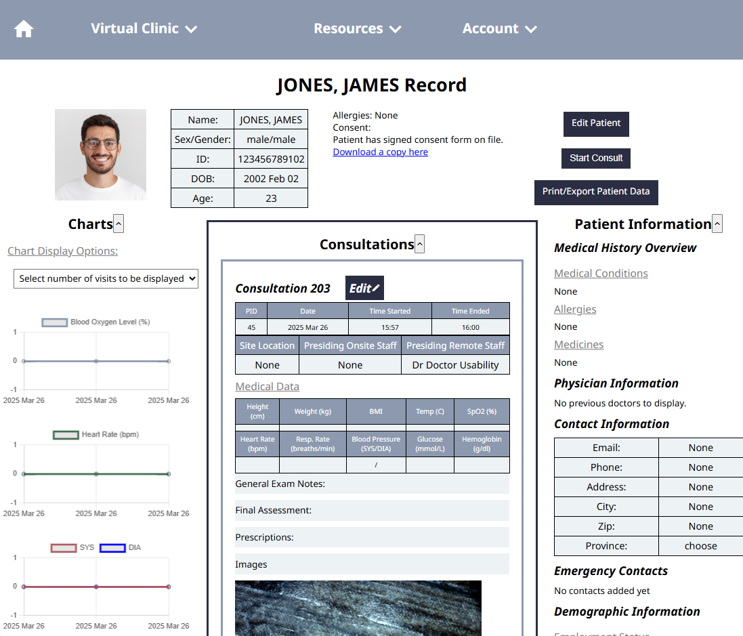
Now we can see the patient’s information. Looks like they’ve been coming to this clinic for a while! But they must not have had any measurements taken at their previous few appointments. That’s okay, because we’ll take some measurements today.
Click to continue →

Slide 5
Now, let’s start the consultation. Click the ‘start consult’ button at the top to begin the consultation.

Slide 6
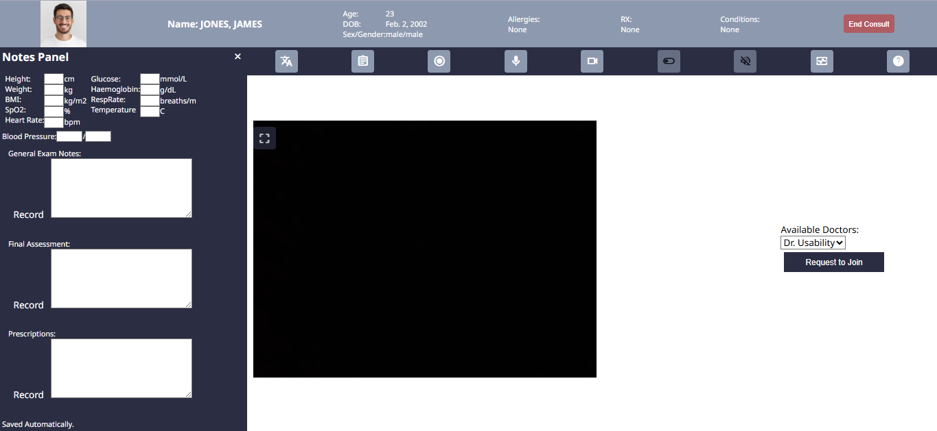
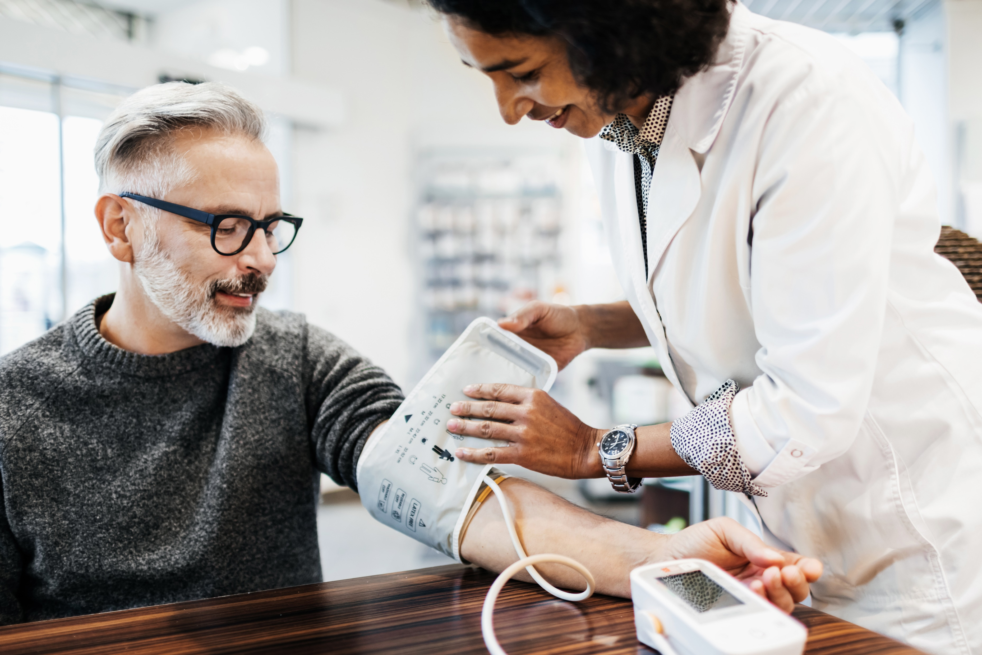

You’ve made it into the consultation now. ‘You’ and your patient are shown on the left. Looks like the doctor has arrived as well! He is shown on the right.
Click to continue →

Slide 7
It’s important to record each consultation, so that if necessary, it can be referred to later.
Start the recording by pressing the record button on the top menu. (Hint: it looks like two circles)

Slide 8
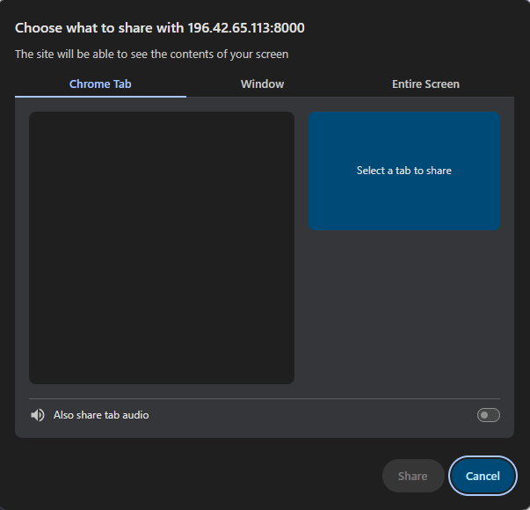
You will see a popup window like this.
Go to the ‘Entire Screen’ Tab

Slide 9
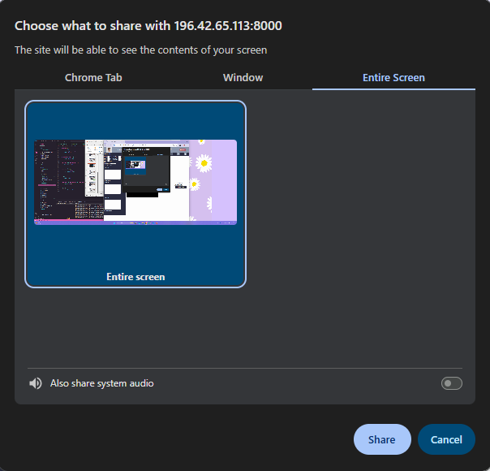
Now, select the box that says ‘Entire Screen’ in the middle section.

Slide 10
Every time you record, you should make sure that you are recording audio. To do this, check that the button at the bottom next to ‘Also share system audio’ is on (blue).
Right now, the button is off (grey). Turn it on by clicking it.

Slide 11

Finally, click ‘Share’ at the bottom to confirm the recording.

Slide 12
Great! The recording is now started, and will automatically save to the patient’s profile once you or the doctor end the consultation.
Click to continue →

Slide 13
Your patient is complaining of a headache that they’ve had since this morning.
The doctor would like to know the patient’s SpO2, blood pressure, and temperature.
Click to continue →

Slide 14
Use the vital signs monitor to collect these three pieces of data.
You can write these down in on a piece of paper for now.
Click the button to continue when you have captured the three measurements.
Click to continue →

Slide 15
Great! On the platform, you will type in this information.
For now, it will be filled in for you.
99
37
120
80
Click to continue →

Slide 16
Whenever you enter information into the platform, it automatically is sent for the doctor.
Whenever you are the doctor are typing in a box, the box will be disabled for the other user to prevent confusion (as seen here).
So, if you aren’t typing something, make sure not to click on it!
99
37
120
80
Click to continue →

Slide 17
After discussion, you all agree that the patient is likely experiencing a migraine which can be self-managed for the next 24 hours.
They are advised to return tomorrow if they are still experiencing pain or if pain worsens significantly.
99
37
120
80
The patient has a suspected migraine. The patient is prescribed to take ibuprofen , 200mg 3x within the next 24 hours. If they are still experiencing issues , they should return to the clinic tomorrow.
Click to continue →

Slide 18
99
37
120
80
The consultation is now over. End the consultation by pressing the ‘end consult’ button.
The patient has a suspected migraine. The patient is prescribed to take ibuprofen , 200mg 3x within the next 24 hours. If they are still experiencing issues , they should return to the clinic tomorrow.

Slide 19
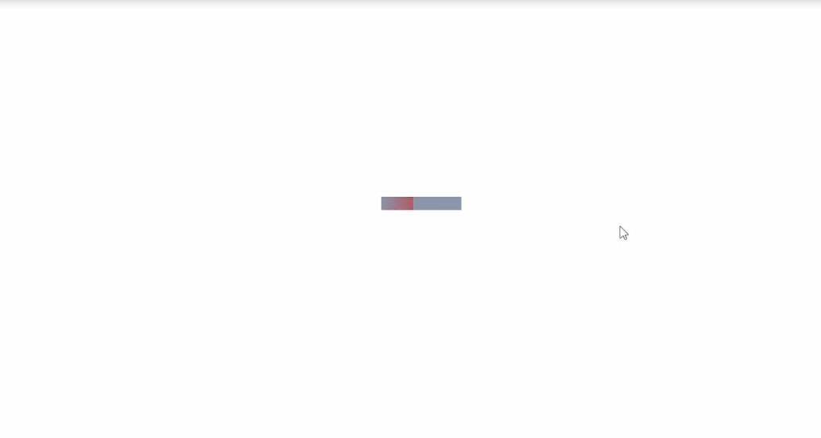
You’ll see a loading screen like this appear. It may load for a few minutes while the recording is saving.
Do not exit out or change the page while it’s loading!
Click to continue →

Slide 20
Great! The new consultation will now appear on the patient record. You can see that the notes and measurements have saved.
37
99
120
80
The patient has a suspected migraine. The patient is prescribed to take ibuprofen , 200mg 3x within the next 24 hours. If they are still experiencing issues , they should return to the clinic tomorrow.
Click to continue →

Slide 21
Congrats! You have finished your Tutorial 1.
You now know how to:
Get to a patient’s record
Start a consult
Record a consult
Take vital signs
Enter notes
End a consult
You are ready to try Tutorial 2.

